Slide 1
RADAR Model using Ultrasonic Sensor
St. Francis Institute of Technology
Information Technology
IoT Mini Project (ITL504)
KOMAL TORLIKONDA 25
SOUMYA SHETTY 27
NIHARIKA WALKE 38

Slide 2
Introduction
By using Internet of Things , our Arduino RADAR project aims to achieve a radar system prototype based on an Arduino board, capable of detecting stationary and moving objects.
Detection of range, altitude and depth of the objects.
A Buzzer is used to alert the authorities.
The radar continuously monitors the environment as soon as the object is detected, the detected data is processed and sent to the authority-it is then verified if the distance is too close or not.

Slide 3
Literature Review
In [1], the authors have proposed a system, to increase range of the ultrasonic sensor underwater, for range detection.
In [2], the authors have proposed a system, for object detection in 360° with DC Motor, with distance calculation with ultrasonic sensor, along with Radar Screen in Processing IDE.
In [3], the authors have proposed a system, for object detection in 360° with servo motor, with distance calculation with ultrasonic sensor, along with Radar Screen in Processing IDE.
In [4], the authors have proposed a system, for obstacle detection for self-driving cars, or as a Vehicle Driver Assistance.
In [5], the authors have proposed a system, for object detection in foggy type of environments for vehicle drivers and self-driving cars.
In [6], the authors have proposed a system, for detecting obstacles like potholes and humps and alerts the vehicle driver about it via a buzzer.

Slide 4
Problem Statement
This mini-project aims to develop an IoT based RADAR model, that will find the distance, and if the object enters a specific range then the red led will be turned on, and if the object moves out of the range, then this led will be turned off.
The second aim of this project is that the user will receive the distance between the sensor and the object or any obstruction in the BLYNK app. The resulted distance will be displayed on the LED screen of this app.

Slide 5
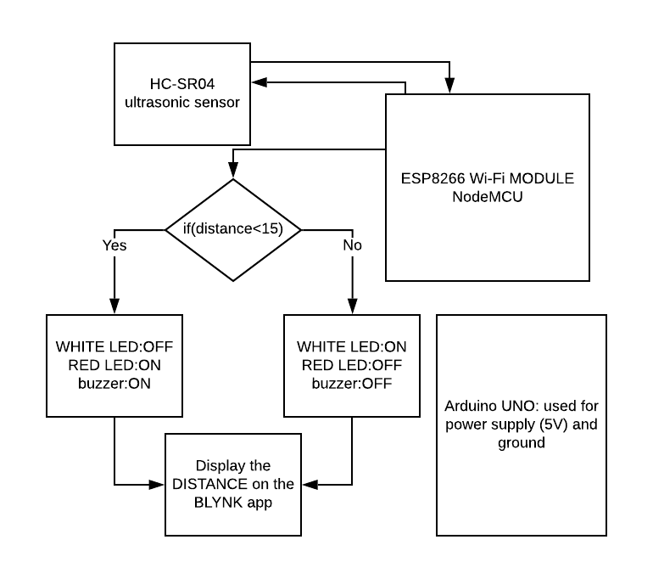
System Design

Slide 6
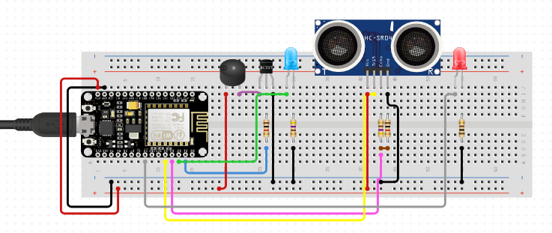
Circuit Diagram

Slide 7
System Requirements & Cost
Sr No. | Hardware
1 | Arduino UNO R3-USB compatible
2 | NodeMCU ESP8266
3 | Ultrasonic sensor HC-SR04
4 | Buzzer
5 | Connecting(Jumper) wires
6 | Bread board
7 | 2 LED’s
 | SOFTWARE
1 | Arduino IDE

Slide 8
System Requirements & Cost (continued..)
Sr No. | Components | Cost(Rs.)
1 | Arduino UNO R3 | 500
2 | NodeMCU ESP8266 | 300
3 | Ultrasonic Sensor HC-SR04 | 900
4 | Bread Board | 100
5 | Buzzer | 60
6 | 2 LED’s and connecting wires | 150

Slide 9
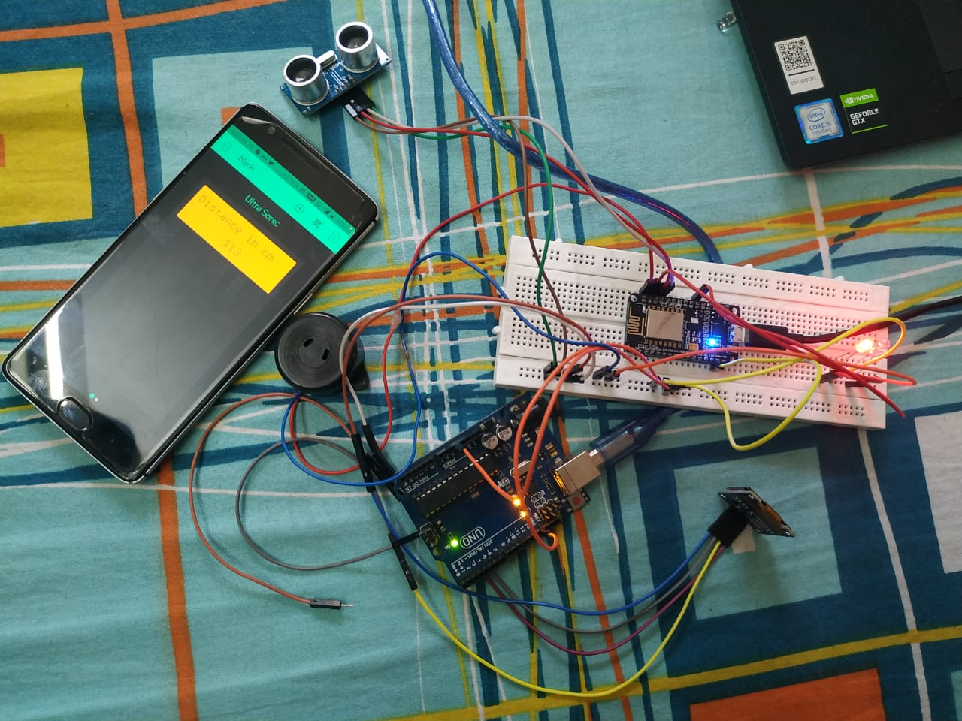
Results
Result displayed in Mobile

Slide 10
References
[1] Hamdy Youssef Hussein Aly, Saud Salem Almusallam, “Maximizing Range Using Ultrasonic Sensor and Arduino”, Journal of Engineering Research and Application , Rep. ISSN : 2248-9622 Vol. 9,Issue 3 (Series –III), March 2019.
[2] Arun Francis G, Arulselvan M, Elangkumaran P, Keerthivarman S, Vijaya Kumar J, “Object Detection Using Ultrasonic Sensor”, International Journal of Innovative Technology and Exploring Engineering (IJITEE), Rep. ISSN: 2278-3075, Volume-8 Issue-6S, April 2019
[3] Haraa Raheem Hatem, Zainab N. Abdulhameed, Zainab Najeeb, Ali I Abdalla , “Design and implementation of ultrasonic radar system for distance”, University of Diyala, Rep. DOI: 10.14419/ijet.v7i4.18103, January 2018

Slide 11
References (continued)..
[4] James I. Obuhuma, Henry O. Okoyo and Sylvester O. McOyowo, “Shortcomings of Ultrasonic Obstacle Detection for Vehicle Driver Assistance and Profiling“, I.J. Information Technology and Computer Science, Rep. DOI: 10.5815/ijitcs.2019.06.04, June 2019
[5] Pallavi C, U. Aditya Karanth, Priya B, Ramya S, Dr. M. Devanathan, “Object Detection System for Vehicles in Fog Environment”, International Journal of Scientific Research and Review, Rep. ISSN No.: 2279-543X Volume 07, Issue 03, March 2019
[6] V. Kalpana, “Implementation of Vehicle Speed Reducing System at Speed Breaks by Detecting Patholes and Humps Using Ultrasonic Sensor”, International Journal of Recent Technology and Engineering (IJRTE), Rep. ISSN: 2277-3878, Volume-7, Issue-5S3, February 2019

